Slide 1
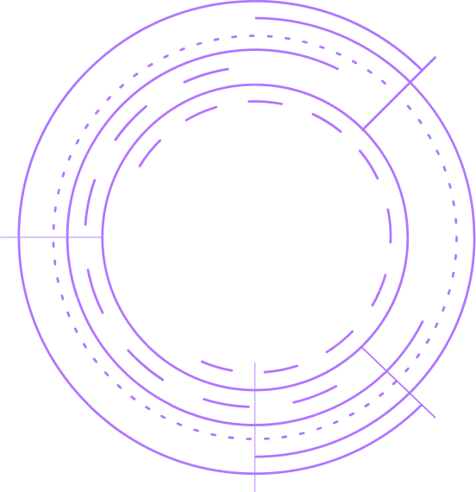






CERBERUS – Biometric Attendance for CA Dept.

Slide 2
Cerberus - Live Project
Guide:
Mr. Krishnanand Rastogi
Team Members:
Ebenezer Isaac [522025]
Lokhandwala Haji Huseinali [522035]
Vraj R. Kotwala [522033]

Slide 3



1.
Project Summary
Let’s start with the first set of slides

Slide 4
Our project focuses on managing a distributed system of devices that are capable of scanning biometrics for the use of attendance for a large scope of stakeholders automatically on the basis of a timetable.

Slide 5
The student will be marked present through biometric (fingerprint) module and the attendance data can be accessed on our website by the users.

Slide 6
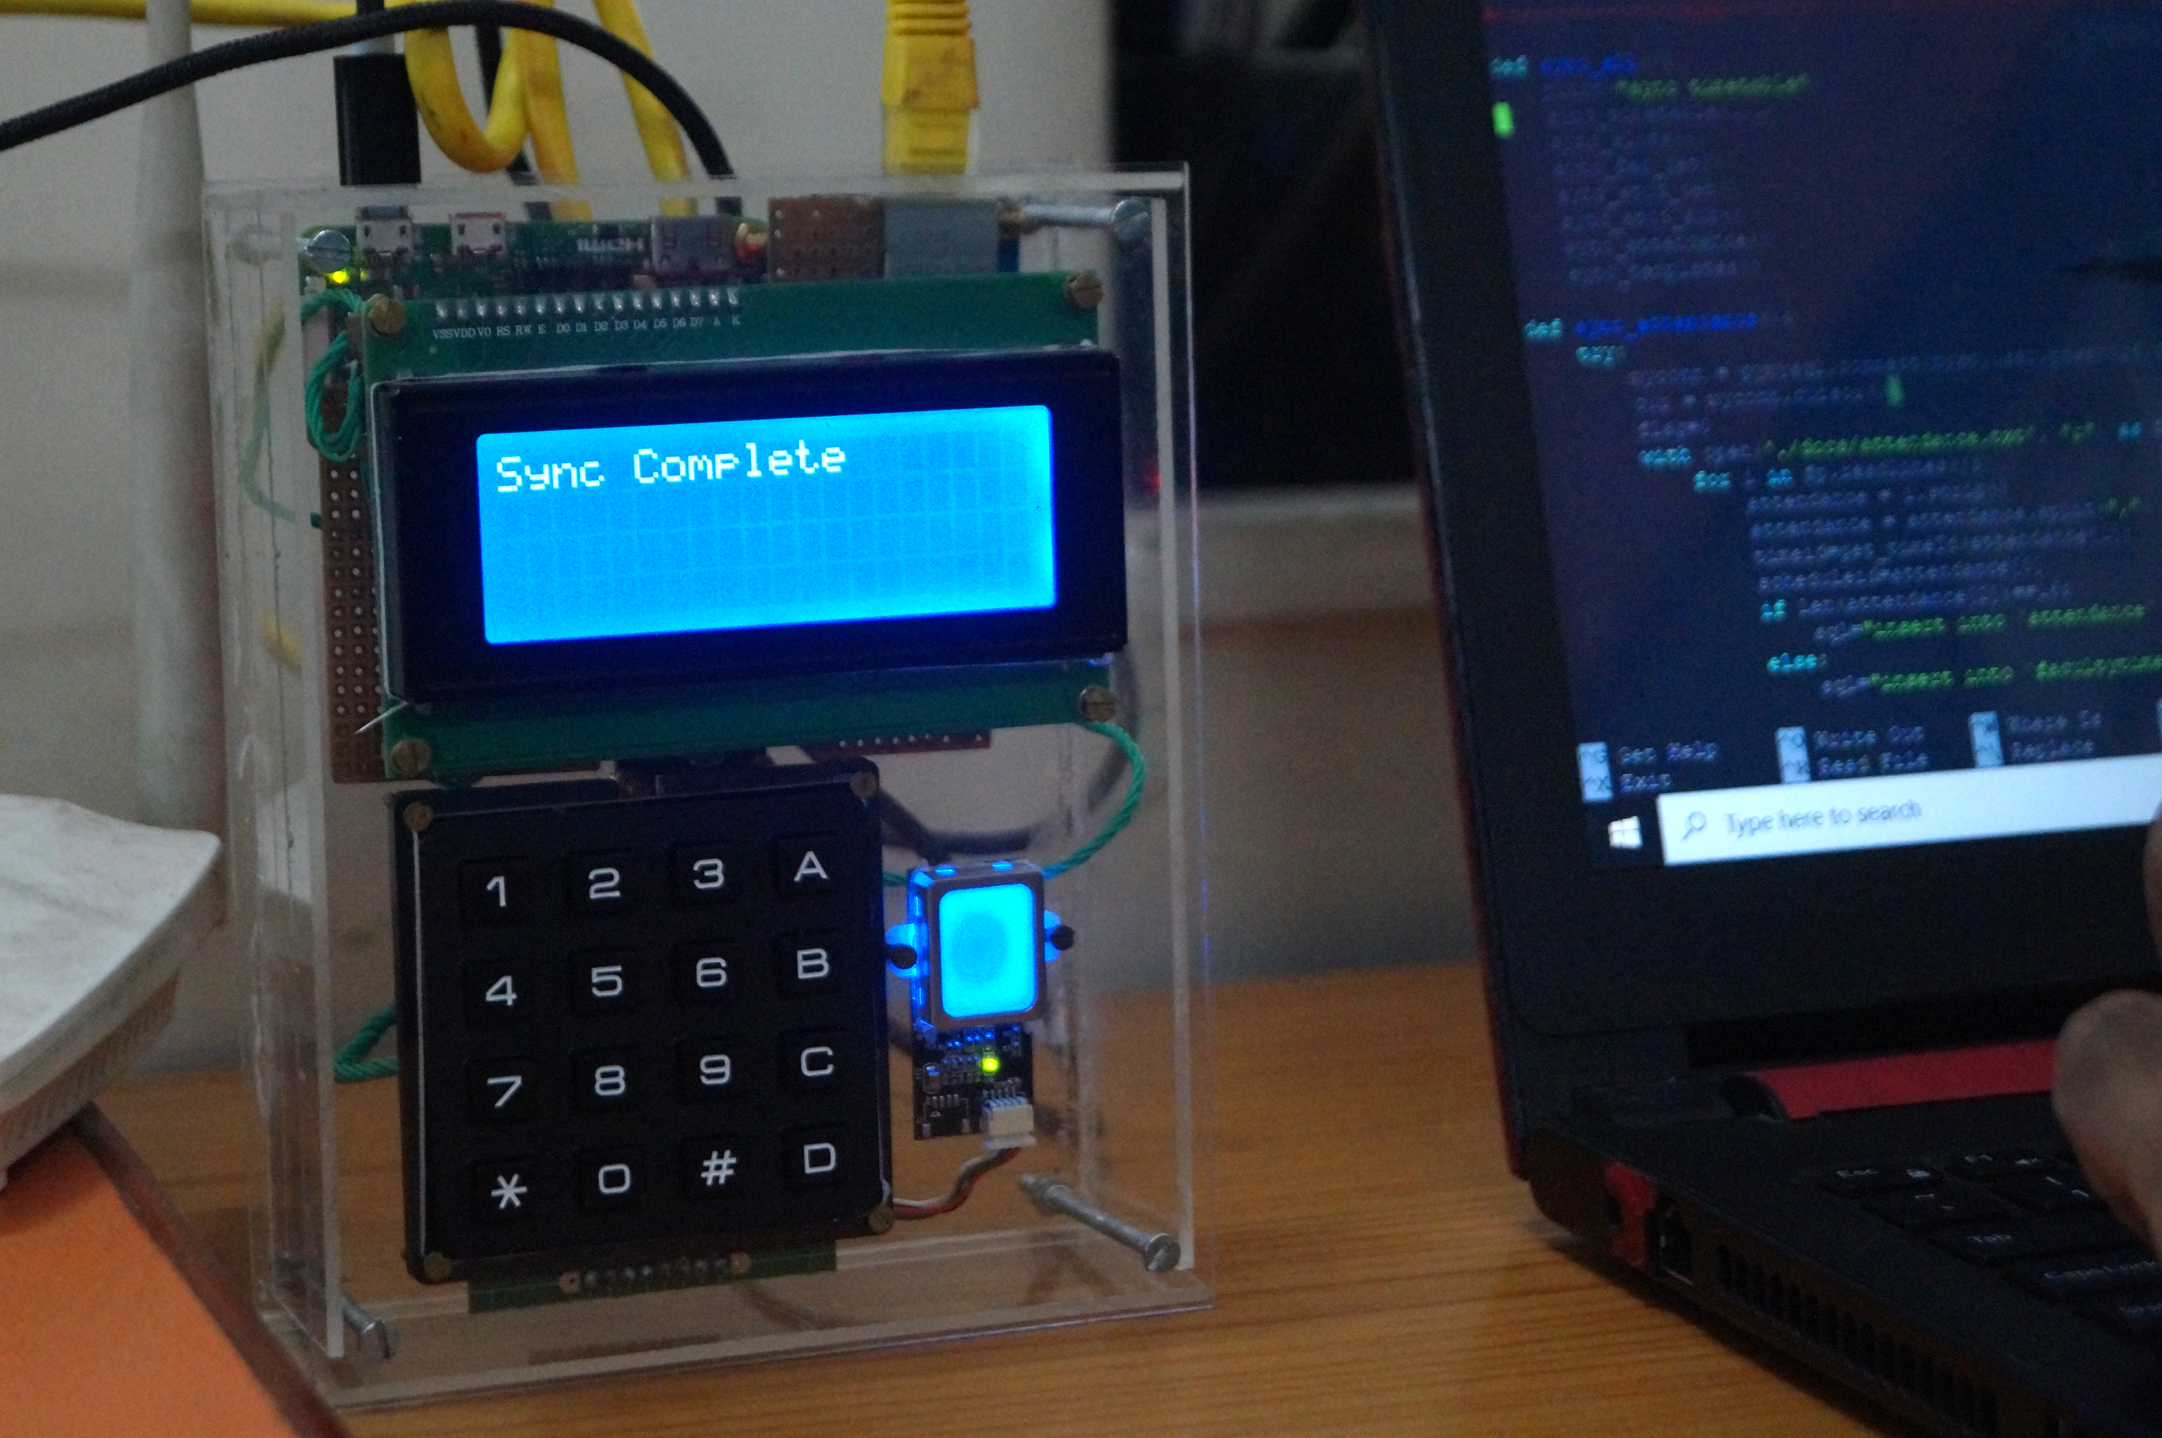
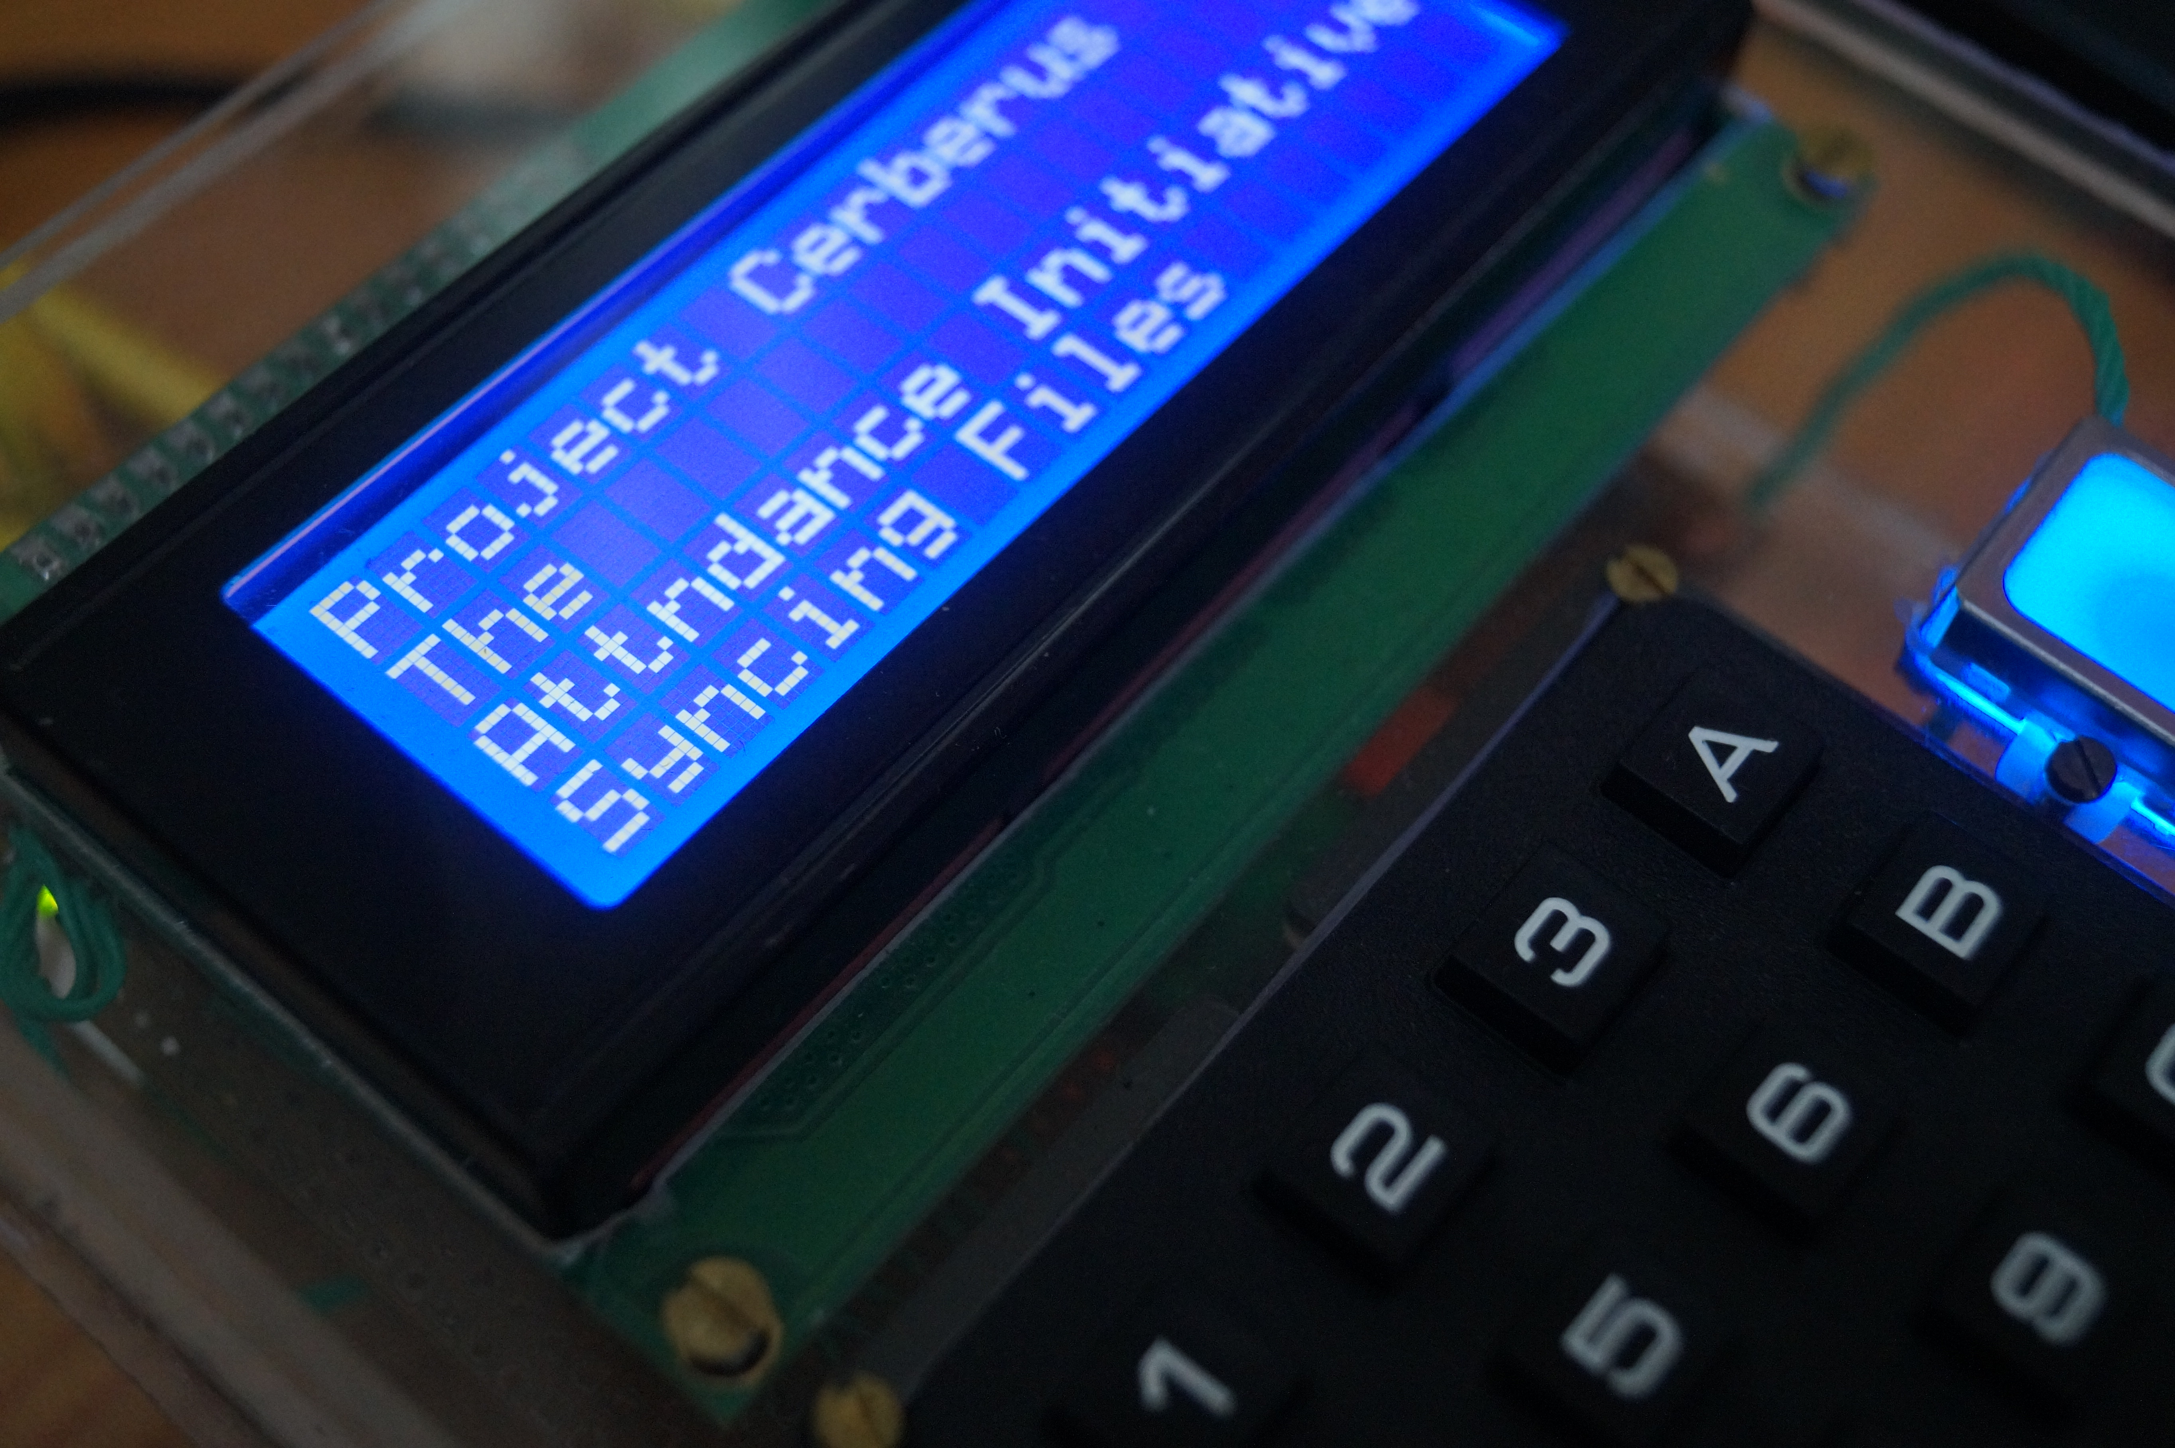

Slide 7
Flow-Chart of RaspberryPi

Slide 8
Scope of Device (w RaspberryPi)
Enroll fingerprints
Authentication
Manage Faculty/ Admin (Fingerprint data)
Manage Student (Fingerprint data)
Background Activities:
Sync:
Attendance to database
Sync templates from database
Sync timetable from database.
Sync Student Details (PRN, subject, name, fingerprint)

Slide 9
Scope of Web-App (made w Servlet)
For Faculty:
Login
Timetable Management
Subjects Management
Student Management
Attendance Management (Manual)
Admin Management
Student Progression
Profile Management
For Students:
Login
View Attendance
Select Electives

Slide 10
Tools and Technology Used:
On Device (RaspberryPi):
OS: Raspbian
Lang: Python
Tool: Notepad++, Jupyter, PuTTY
On Web-App:
frontend:
AJAX, HTML, JS, CSS
backend:
Java-Servlet, JSP.
Database: MySQL
Server: Apache Tomcat 7.0.3

Slide 11
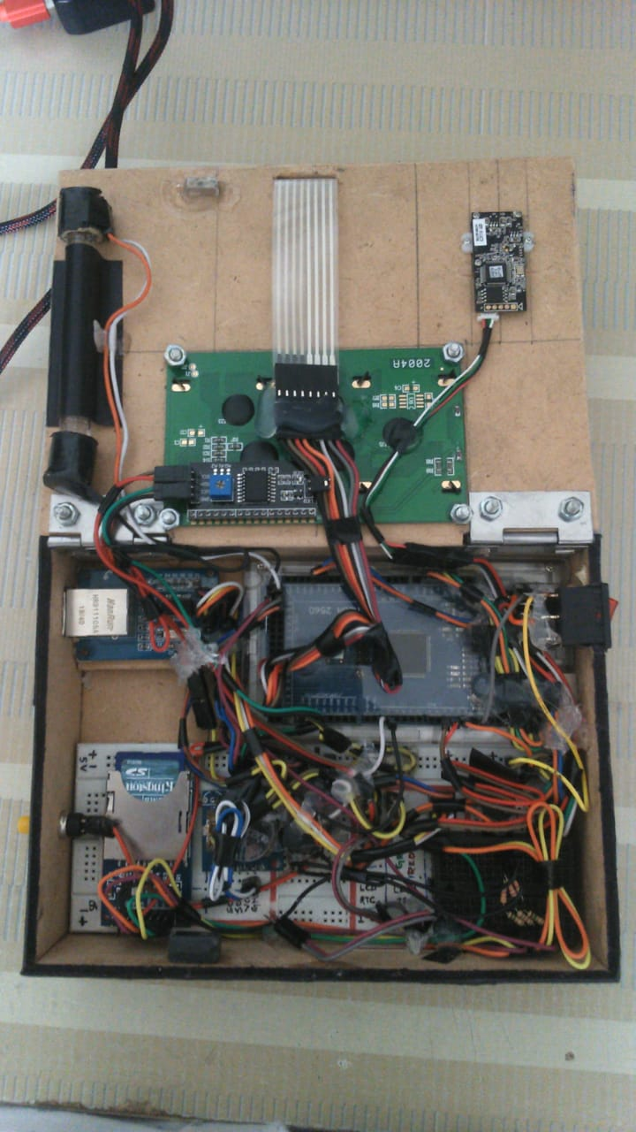
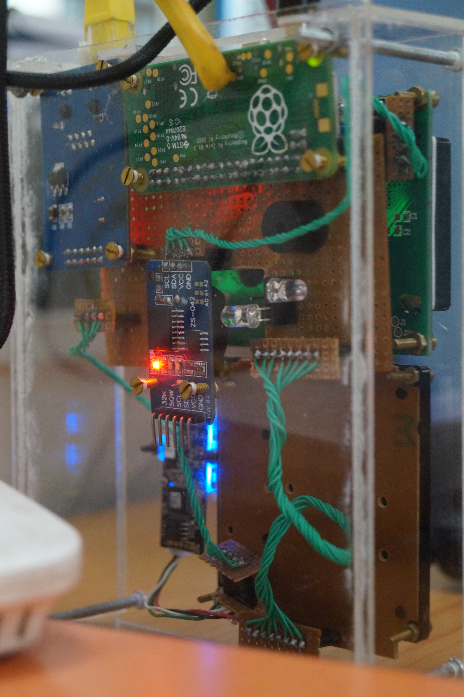
Circuit of
Arduino vs RaspberryPi

Slide 12
We switched to RaspberryPi
Feature | Arduino Mega | RaspberryPi Zero
RAM | 8 KB | 512 MB
Download Speed | 16 KBPS | 10 MBPS
OS | - | Linux Raspbian
Multitasking | No | Yes
Price | 850 | 990
Download/Upload Templates from/to FPS.
Support for multiple SPI interface
Inbuilt SD card support

Slide 13








Agile Methodology
To iterate the development and testing throughout the software development lifecycle of the project.
Extreme programming (XP) is a software development practice which is intended to improve software quality and responsiveness to changing customer requirements.

Slide 14
Backlogs
Testing components/ Modules.
FPS, LCD Libraries
Custom functions for RaspberryPi
Database connection with RaspberryPi
Launcher functions for RaspberryPi
Sync fingerprints
Switching to GitHub for version control.
Commercializing the project
Circuit Diagram for Arduino/ RaspberryPi
Blob/Clob for finger data
Database Schema
View Attendance
View Timetable
Edit Timetable
Manage password
Password encryption (SHA2)
Edit timings
Add slot
Remove slot
View Student Details
Student Subject Selection
Add Student
Delete Student
Manage Subjects (Add, View, Delete)
Faculty Management (Add, View, Delete)
Final Database Normalization

Slide 15
Backlogs 2
Adding logs
Dividing storage space into classes
Simultaneous interaction of SPI Devices.
Ethernet Sleep mode.
Add light show for standby
Download data to excel (Backup)
Upload student data from excel file.
Profile Page
Activity log
Session Management
ReCAPTCHA
Mailer
OTP
Email verification
Handle SQL Exceptions
Validations in forms (AJAX)
Animations using CSS and JS
Particle.js
Theme and logo
Box Design
Student Progression
JSON format data
Testing
About Us page
Copy timetable from previous week
Fix scrollbar
First login asks for details
Manual Attendance
Email and network connectivity check
Documentation
Presentation

Slide 16
GitHub Demo w User Stories

Slide 17
Excel file with sprint and backlogs

Slide 18
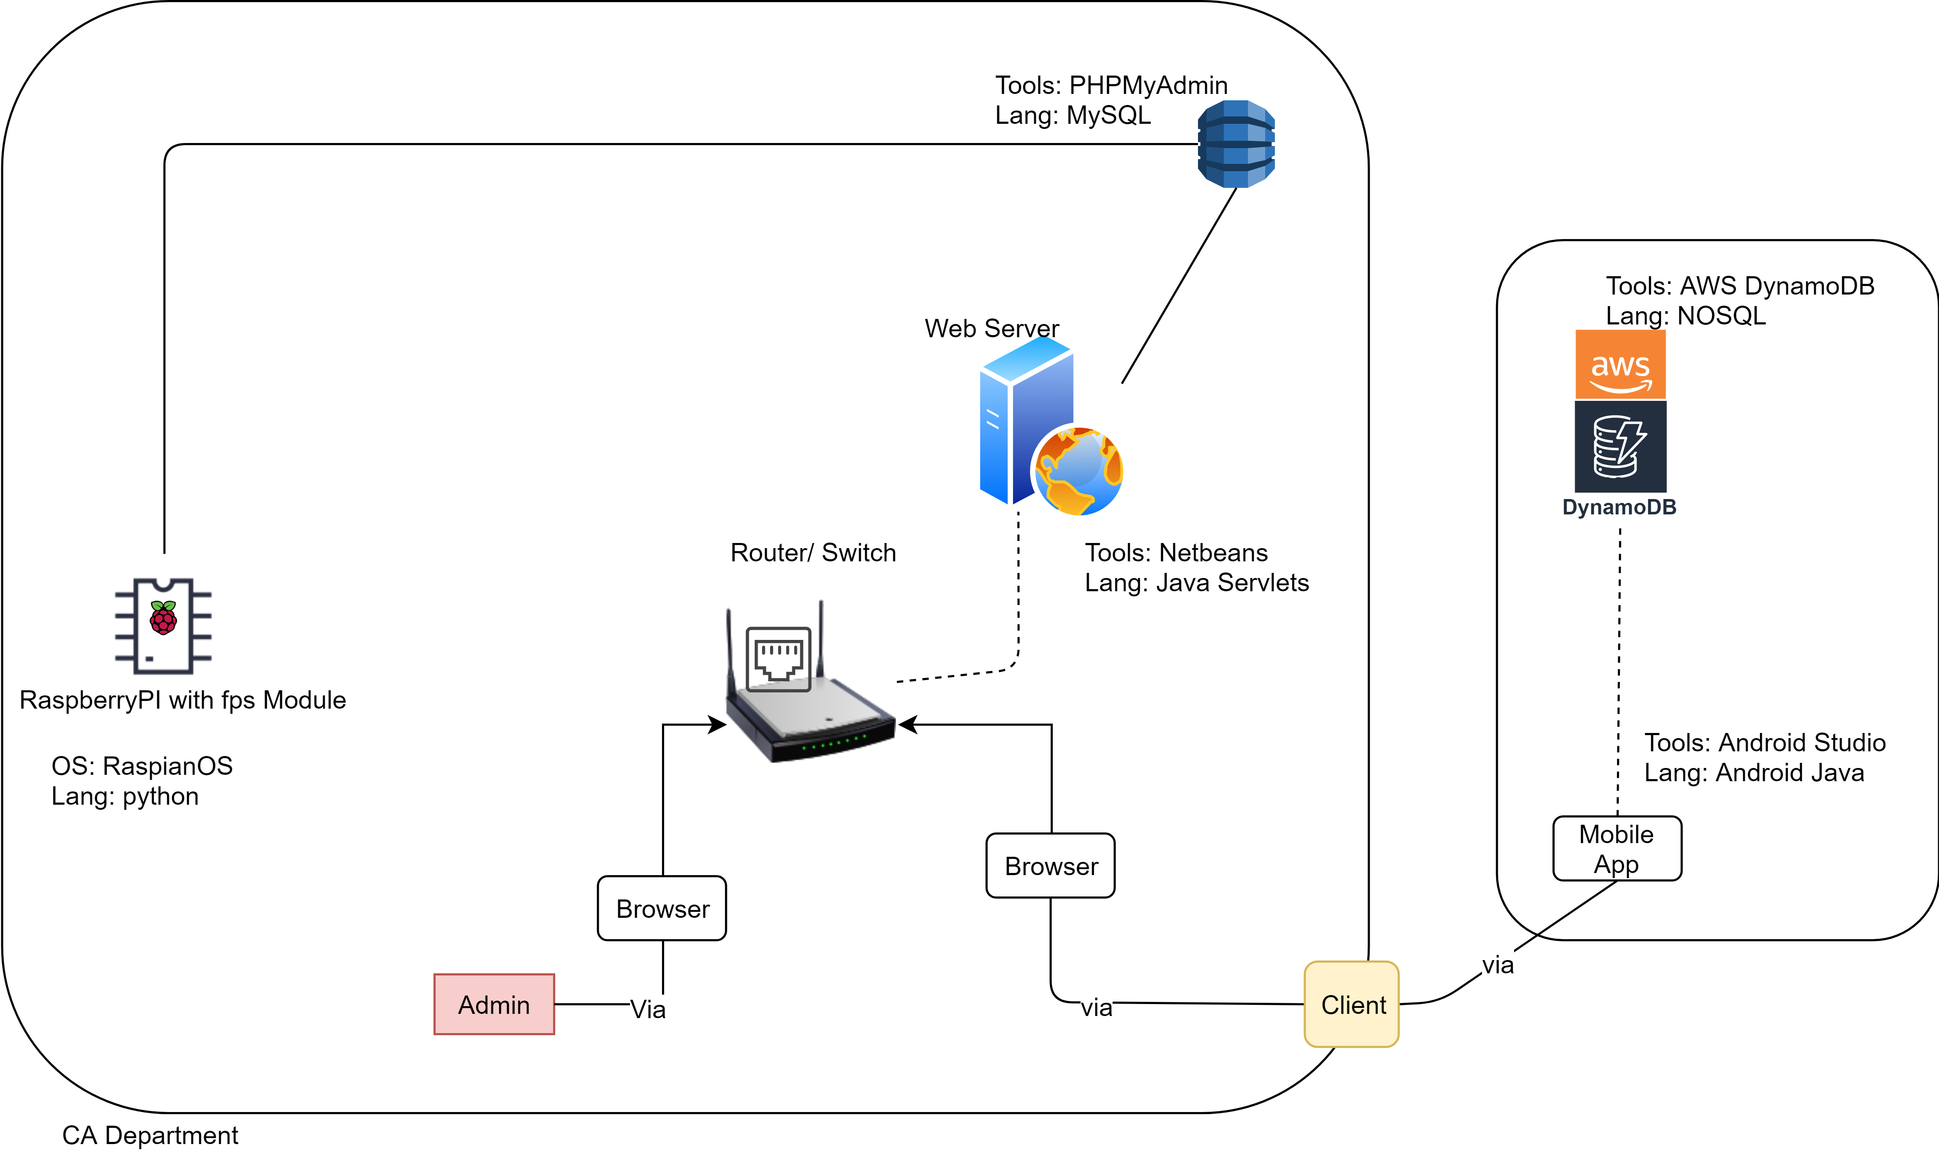
System Architecture

Slide 19
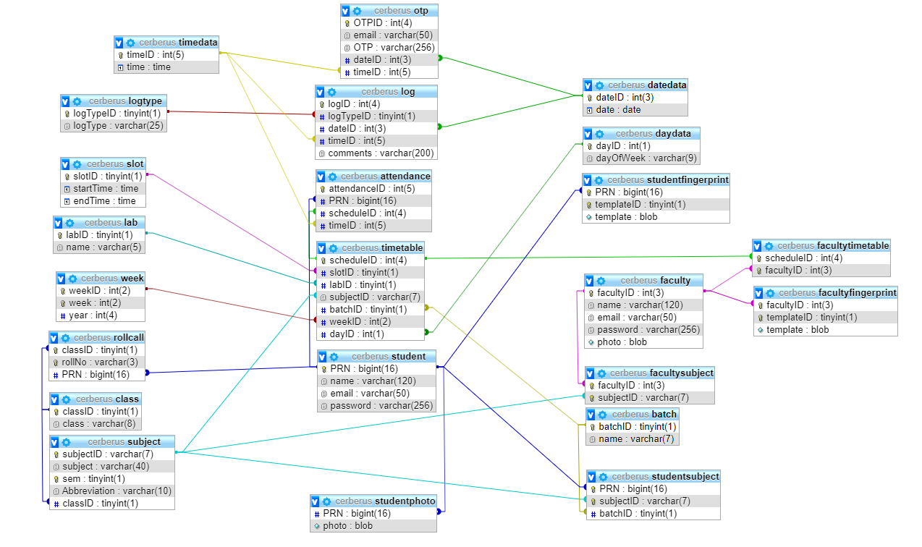
System Design – ERD (Relational)

Slide 20
Tables and database dictionary from phpMyAdmin

Slide 21
2.
Implementation
ScreenShots and Live Demo

Slide 22
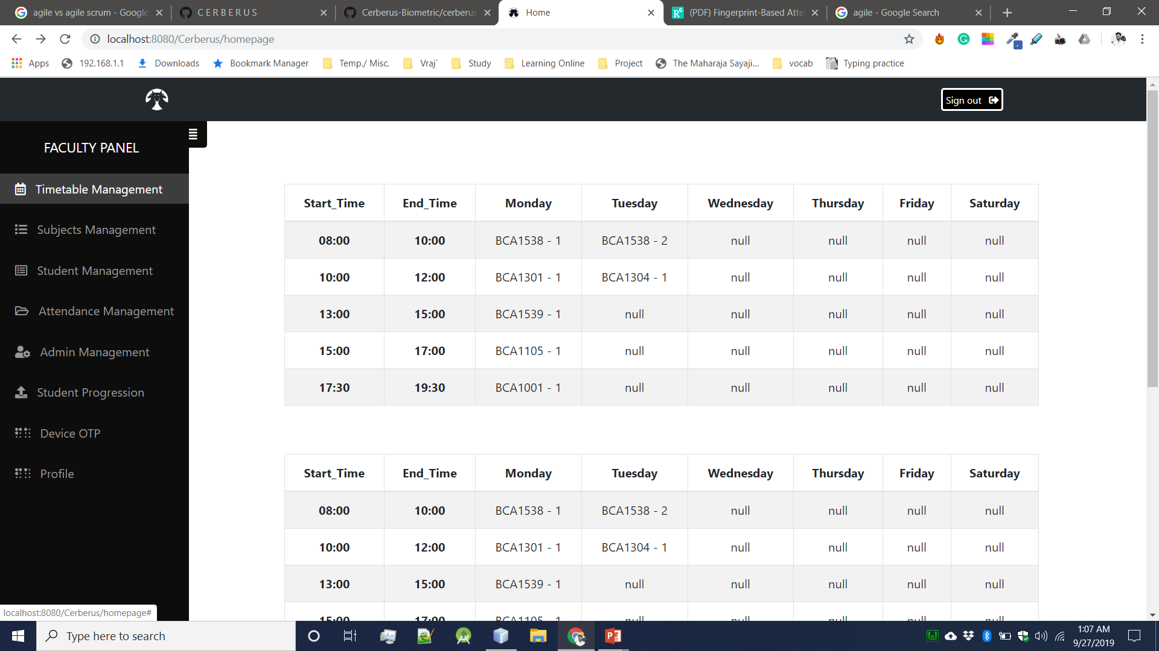
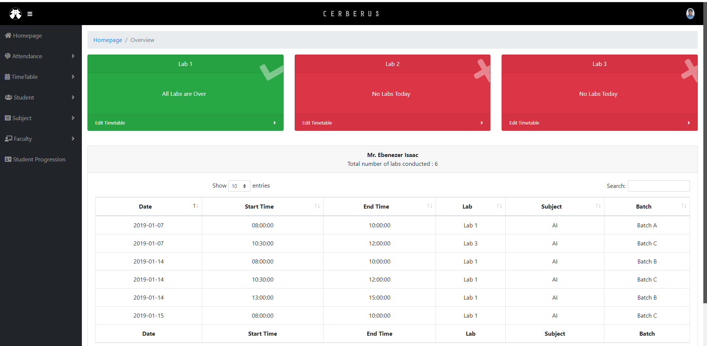
Desktop project (Web)
Home page when faculty logs In.
Place your screenshot here

Slide 23
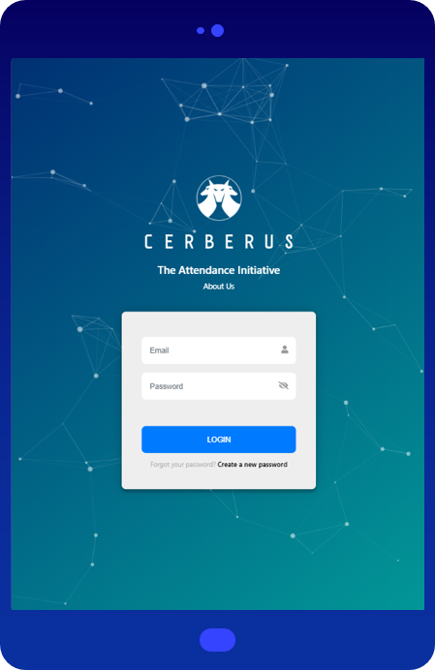
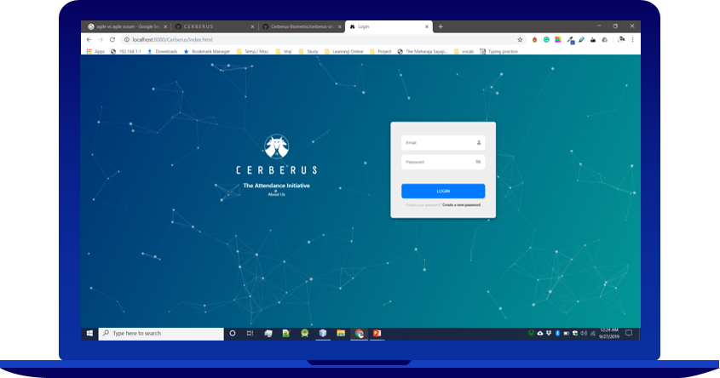
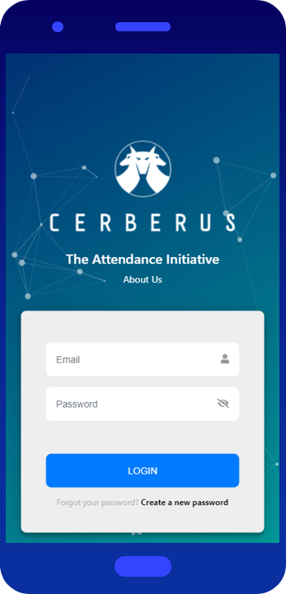
Desktop project (Web)
Tablet project
Mobile project

Slide 24
Demo of RaspberryPi and Web Application

Slide 25

Finance
RaspberryPi + Heatsink | 1035
FPS Module | 1604
Ethernet Module | 250
RTC Module | 110
Screen | 450
Keypad | 390
SD Card | 250
Box Design | 250
Misc. | 150
 | 4490

Slide 26
Project Work Division
Coding on RaspberryPi: Ebenezer
Raspberry Circuit Design: Ebenezer
Box design: Vraj.
Backend: Ebenezer & Vraj
Front end & GUI: Huseinali, Ebenezer
Database & SQL: Vraj
Documentation: Vraj
Testing: All 3 of us.

Slide 27

Thank you!

